Slide 1

Beyond the Aging Curve:
A Bayesian Framework for Distinguishing and Quantifying Injury vs. Natural Decline in MLB Pitchers
Nickolas Bartle | Wake Forest University Baseball Analytics
SABR Analytics Conference 2026
Notes:
Good morning (evening?) everyone. My name is Nickolas Bartle, and I'm a graduate baseball analytics researcher at Wake Forest University. Today I'm excited to share research that tackles one of baseball's most persistent evaluation challenges: when we see a pitcher's velocity declining, how do we know whether we're looking at natural aging or injury-related deterioration? This distinction matters enormously for contract negotiations, roster decisions, and long-term player development.
Over the next XX (20?) minutes, I'll walk you through a Bayesian framework that quantitatively separates these effects, show you real-world case studies, and discuss practical applications for front offices and player evaluation teams. Transition - Let me start by framing the problem more concretely:

Slide 2



About Me
I’m a current graduate analyst for Wake Forest Baseball, while completing my MSBA in May 2026. I primarily work in pitching analytics and predictive modeling.
Nickolas Bartle
nickbartle2@gmail.com (919)-656-2434
Wake Forest MSBA
Graduate Baseball Analyst
Eagle Scout
I served as a baseball analyst for Alabama Baseball, while also completing my undergraduate Bachelor’s of Science in Management Information Systems.
linkedin.com/in/nickolasbartle/
https://nbartle26.github.io/DigitalPortfolio/
Notes:
Talk about myself. I’m a yapper. No Biggie.

Slide 3

The Problem
When a pitcher's velocity drops, is this:
expected natural aging
worrisome injury-related decline
a mix of both
Notes:
Here's the scenario every front office faces: You're watching a 32-year-old veteran pitcher whose fastball has dropped from 94 to 92 mph over the past two seasons. The question is, is this the natural aging process we should expect and price accordingly? Or is this early warning of injury-related decline (Tommy John) that will accelerate further?
The consequences of getting this wrong are significant. If you misread aging as injury, you might let a productive pitcher walk in free agency when they still have 3-4 good years left. Conversely, if you mistake injury decline for normal aging, you might commit $15-20 million per year to a player whose performance is about to fall off a cliff.
Traditional approaches have treated aging curves and injury research as separate questions, or in my experience are at least not publicly widespread available (plus my curiosity almost always gets the better of me!). But in reality, they're deeply intertwined, especially with Tommy John surgery becoming so prevalent. That's the gap this research addresses.
Transition: So what exactly are we trying to answer?

Slide 4

Research Question
PRIMARY QUESTION:
Can we quantitatively separate natural aging effects
from injury-related decline in pitcher velocity?
SUPPORTING QUESTIONS:
1. What is the population-level aging pattern for pitcher velocity?
2. When do velocity declines typically occur?
3. What are the immediate and lingering impacts of Tommy John surgery?
4. Can we predict future decline risk?
Notes:
Our primary research question is: Can we quantitatively separate natural aging effects from injury-related decline in pitcher velocity?
To answer this comprehensively, I broke it into a few targeted supporting questions:
First, what is the population-level aging pattern? We need a baseline to know what 'normal' looks like (within the dataset I’m using)
Second, what is the specific measurable impact of Tommy John surgery? Not just 'does it hurt velocity' but by how much, and does recovery follow a predictable trajectory?
Third, can we identify when individual pitchers deviate from their expected aging curve? If someone is declining faster than the population average, we want to flag that as early as possible.
These questions require different statistical approaches, which is why we developed a three-part methodology."
Notice we're asking for quantitative answers, not just 'does TJ hurt velocity' but 'how much does it hurt velocity' with proper uncertainty quantification. More on this later!
Transition: Here's how we approached this methodologically...
Possible Audience Question(s): (Personal Note)
Why focus on velocity specifically?
- Velocity is the most objectively measurable metric, least subject to ballpark effects or defensive variation, and shows the clearest aging patterns in our preliminary analysis. It is also often the most used analysis in injury analysis and modeling pitcher aging curves in research. We tested command and movement as well, which I'll discuss shortly.

Slide 5

Three-Part Methodology
1️⃣ BAYESIAN HIERARCHICAL MODEL
Estimates population-level aging effects while accounting for individual variation
2️⃣ CHANGEPOINT DETECTION
Identifies when significant declines occur in individual velocity trajectories
Posterior distributions quantify parametric uncertainty via Stan MCMC sampling
Provides future predictions using partial pooling, population mean, and posterior probability
3️⃣ RISK ASSESSMENT FRAMEWORK
Weighted ensemble approach of multiple components
Produces probabilistic risk scores with interpretable categories: Low, Moderate, High Risk
Notes:
We used three complementary statistical methods, each designed for a specific aspect of the problem.
First, a Bayesian hierarchical model. This estimates population-level aging effects while respecting individual variation. The key advantage of the Bayesian approach is that it gives us full posterior distributions, meaning we can quantify uncertainty properly rather than just getting point estimates. We used MCMC sampling via stan_glmer in R, which handles the hierarchical structure and gives us 95% credible intervals for all our predictions.
Second, changepoint detection using the PELT algorithm; that's Pruned Exact Linear Time. This is an automated method that identifies when an individual pitcher's trajectory suddenly shifts. Rather than assuming decline happens gradually, we let the data tell us when structural breaks occur. The PELT algorithm is particularly good because it penalizes complexity, so we don't overfit by detecting false changepoints. In the future I’d like to move to bcp, which is discussed more in my future considerations at the end.
Third, a comprehensive risk assessment framework that integrates six independent factors: the player's current age, current velocity, velocity decline rate, whether they've hit a statistical changepoint, their injury history, and how long it's been since their most recent Tommy John surgery. We combine these into a continuous risk score from 0 to 1, as well as classify them contextually later on.
The output is player-specific projections with full uncertainty quantification, so instead of saying 'this pitcher will throw 93 mph next year,' we say 'we're 95% confident they'll be between 91 and 95 mph, with a median projection of 93.'
This three-part approach gives us both population insights and individual-level precision.“
Possible Audience Question(s): (Personal Note)
Why Bayesian instead of frequentist?
-Two main reasons: first, hierarchical modeling naturally handles partial pooling across pitchers, which improves estimates for players with limited data. Second, we wanted full posterior distributions for uncertainty quantification, not just point estimates with standard errors.
Transition: Let me show you what data we used...

Slide 6

Data & Sample
Data Source
MLB Statcast (Baseball Savant)
2015-2024 Seasons
TJ Data
Open-Source comprehensive MLB injury file (Roegele)
Surgery dates, recovery timelines, surgery type, etc.
Sample Characteristics
1,100+ pitchers analyzed
5,700+ pitcher-season observations
140+ changepoints detected
Ages 20-45 covered
Notes:
Our data comes from MLB Statcast via Baseball Savant, covering 2015 through 2024: exactly 10 seasons. We chose 2015 as our starting point because that's when Statcast measurement became consistent and reliable across all ballparks.
We focused on four metrics initially: average four-seam fastball velocity, walk rate as a proxy for command, horizontal break, and induced vertical break for pitch movement. This gave us over 1,100 unique pitchers and more than 5,700 pitcher-season observations. That's substantial statistical power for population-level estimates.
For Tommy John data, we used Jon Roegele's comprehensive surgical database, which tracks not just whether surgery occurred but the specific date (I recommend checking it out for yourself, there’s a ton of other amazing data and information in it!). This is crucial because it lets us calculate precise recovery timelines. In our sample, 381 pitchers, roughly 35% , had at least one Tommy John surgery, with 30 pitchers experiencing multiple TJ surgeries. That 35% rate might seem high, but remember this is MLB pitchers only, and TJ rates have been climbing throughout this period. This sample size is substantial for population-level estimates and aligns with the scale of published aging curve research (e.g., Bradbury 2009; Fair 2008).
Transition: Now, we initially hypothesized that decline would manifest across multiple dimensions...

Slide 7

Model Development:
INITIAL HYPOTHESIS:
Pitcher decline should manifest across multiple performance dimensions. I hypothesized velocity (arm strength), command (control precision), and movement (pitch quality) would show correlated aging patterns.
✅ VELOCITY (Fastball MPH):
• Clear aging patterns, significant changepoints
• Predictable post-TJ recovery patterns, strong model fit (R² = 0.629)
❌ COMMAND (BB%) and MOVEMENT (Break):
• No systematic age-related patterns detected; high year-to-year variance, no statistically significant clear changepoints
Notes:
My initial hypothesis was that pitcher decline should show up across multiple performance dimensions. I thought velocity would capture arm strength deterioration, walk rate would reflect command precision decline, and pitch movement would indicate quality degradation.
I found that the velocity-only model significantly outperformed the others. It had the best held-out prediction accuracy, the clearest aging signal-to-noise ratio, and the most stable estimates.
Why? I think there are a few reasons. First, velocity is the most directly measured metric, it's literally radar timing of the ball, whereas command and movement depend on pitch location classification and seam orientation (plus a multitude of other factors), which introduce measurement error. Second, velocity has a clearer physiological basis - it's directly tied to arm speed and power generation, whereas command and movement depend on mechanical consistency and pitch sequencing decisions that are more complex.
----Third, Tommy John surgery is specifically a ligament repair that affects arm speed more directly than fine motor control.
Now, this doesn't mean command and movement don't decline with age - they absolutely do. But the signal was noisier and less predictive (at least based off my dataset and using four-seam fastballs). So, we made the methodological choice to focus on velocity where I could achieve the highest precision. I’ll address this more in detail in our limitations later on too.
Possible Audience Question(s): (Personal Note)
Doesn't focusing only on velocity miss important parts of pitcher decline?
-It does - this is a deliberate trade-off for precision. I think velocity gives us the clearest aging signal, but I acknowledge it's not the complete picture. Future work should integrate command and movement, but I wanted to get velocity right first, especially since we’re using four-seam fastballs as the focused pitch type. Additions for future work and some of these mentioned aspects I’ll address more in detail in the presentation.
Methodologically, we prioritized precision over comprehensiveness, I'd rather have highly accurate predictions for one dimension than noisy predictions across three
Transition: So what did we find when we focused on velocity? Let me start with the big picture...“

Slide 8
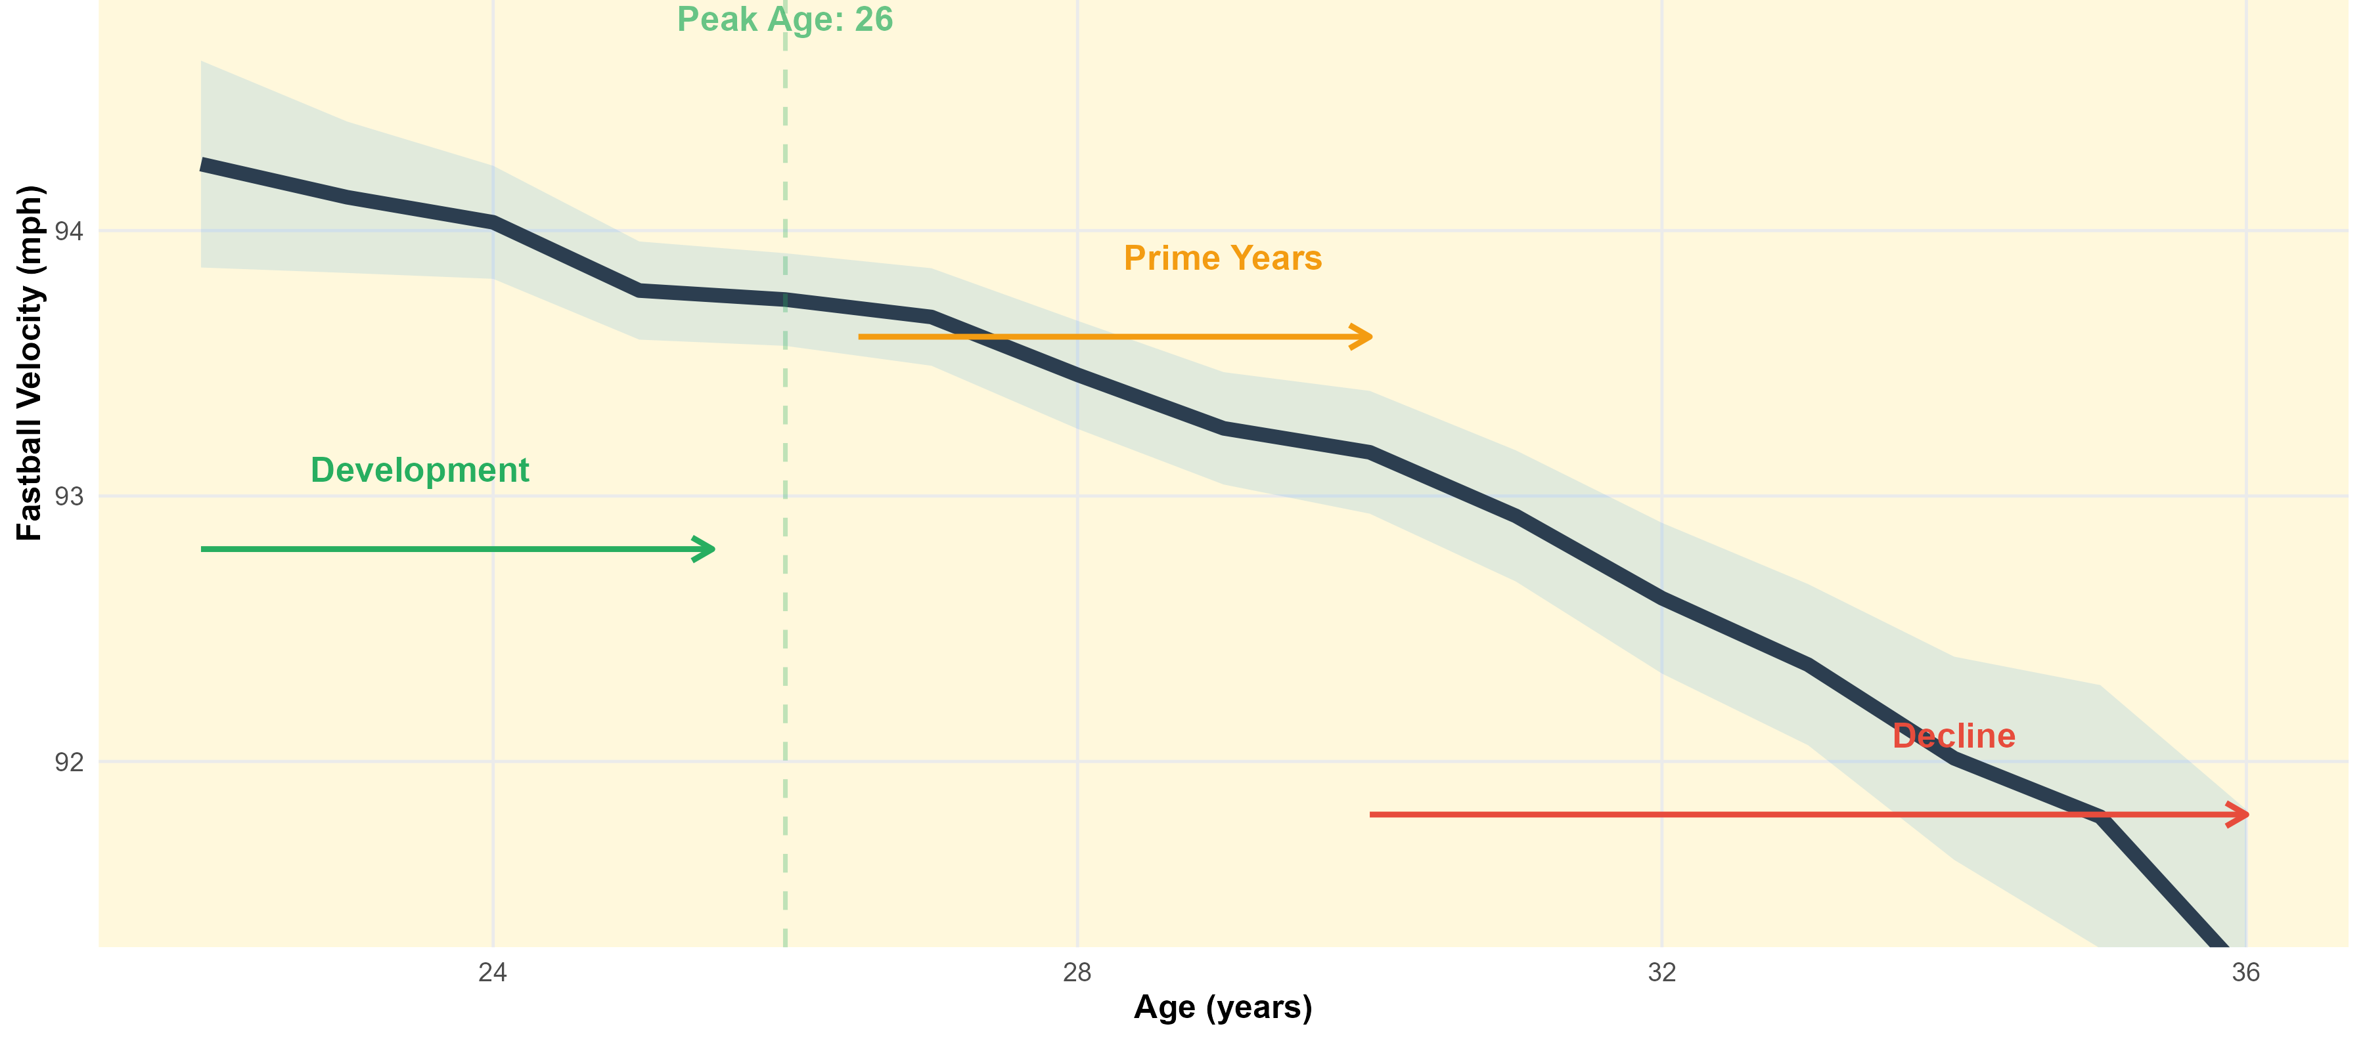
Initial Findings I: Universal Aging Curve
Notes:
This is the population-level aging curve for MLB pitchers, smoothed using loess regression with 95% confidence intervals. This represents over 5,700 pitcher-season observations.
The pattern is striking and matches baseball intuition. Pitchers are still developing through their early 20s, enter their prime years in the mid 20s, then decline gradually but consistently after that. By the mid-30s, the decline accelerates.
What's noteworthy here is the confidence bands, they're relatively tight through the prime years because we have lots of data but widen substantially after age 35 because we have fewer pitchers pitching that long, and the ones who do are a selected sample of especially durable athletes.
This curve serves as our baseline. When we see an individual pitcher deviating from this expected trajectory, that's when we start asking whether something beyond normal aging is happening.
Possible Audience Question(s): (Personal Note)
Why does the peak happen at 26?
-Physiologically, this aligns with peak athletic maturity - players have finished physical development but haven't accumulated significant wear yet. It matches findings from other sports science research on power output."
-Our finding of peak velocity around age 26 aligns with independent research from Driveline Baseball (2021), which found fastball velocity peaks between ages 24-26 before entering decline. This convergence across independent datasets and methodologies strengthens confidence in the age-velocity relationship.
Transition: Lets take a look at some other pitcher velo aging curves industry wide first, then look into when significant individual changes occur...

Slide 9
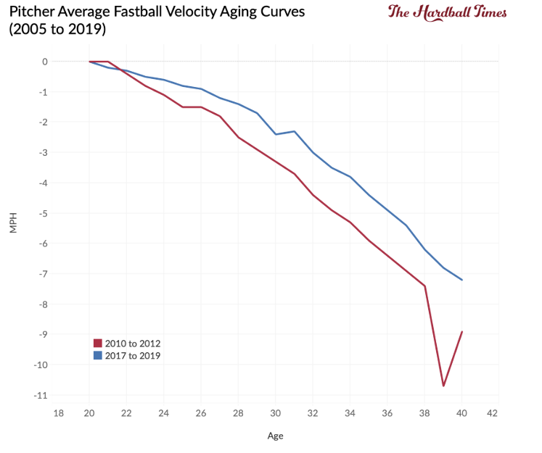
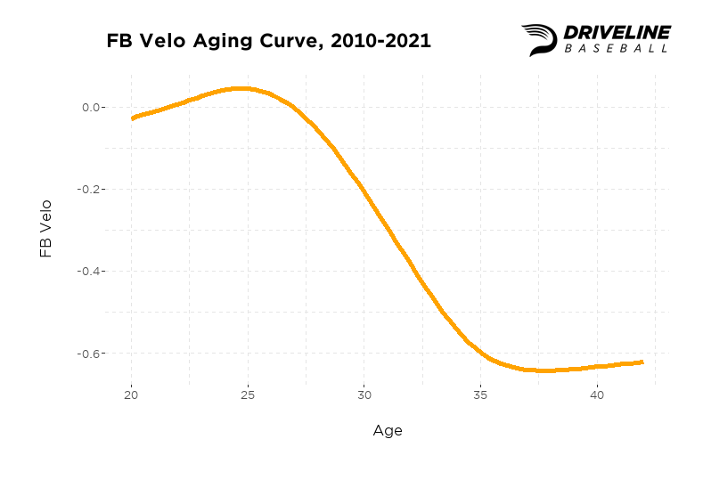
Industry Aging Curves - Driveline
Notes:
Driveline info comparison/reference

Slide 10
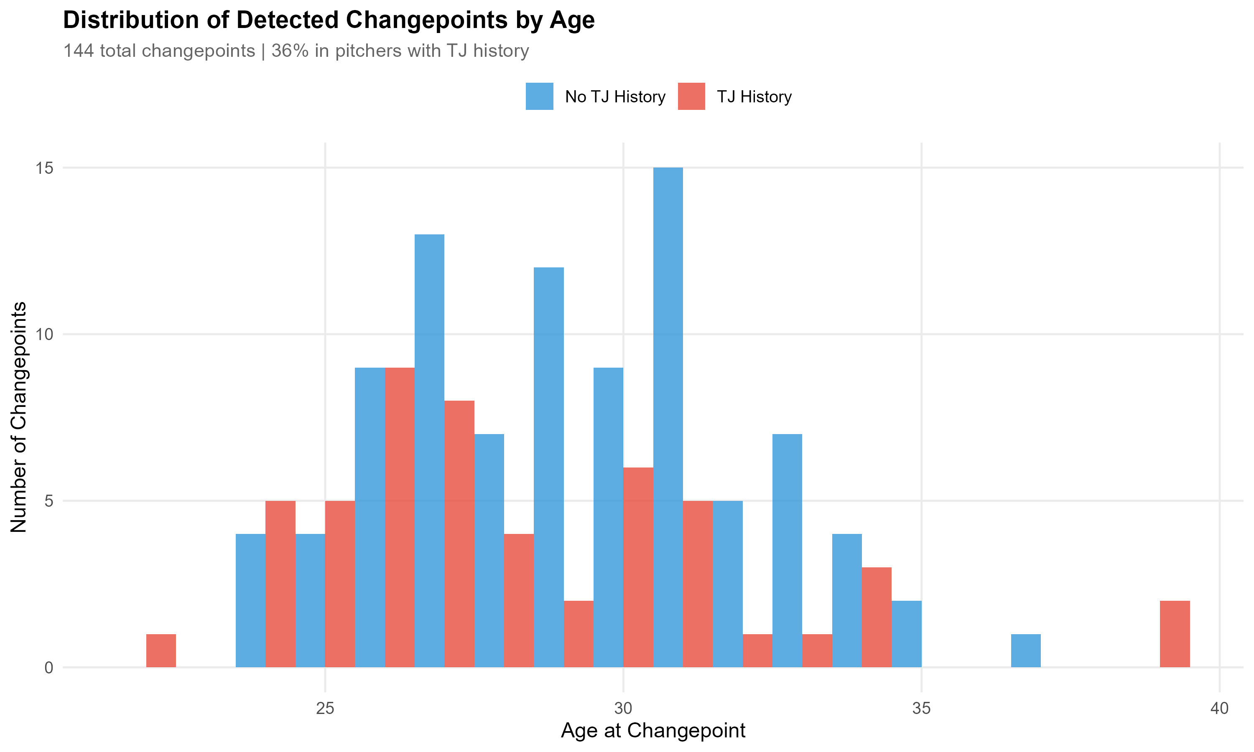
Initial Findings II: When Do Changepoints Occur?
Notes:
Using the PELT changepoint detection algorithm, I identified 140+ statistically significant velocity changepoints across our sample. These are moments when a pitcher's trajectory shifts abruptly, not gradual decline but a structural break in the time series.
Here's what I found: 36% of detected changepoints were validated as corresponding to known TJ injuries. That validation rate is actually quite encouraging, it means my algorithm is identifying real physiological events, not just statistical noise.
The remaining 64% fall into a potential hypothetical few categories: some are mechanical changes, biomechanics, or role transitions - for instance, a starter moving to relief and altering their effort level. Some correspond to undisclosed injuries, remember, not all arm problems result in surgery. And some may reflect training changes or deliberate strategy shifts.
The key insight is that changepoints are detectable before they become obvious. The algorithm flags a shift in trajectory after 2-3 data points, which in our case means we can identify concerning trends within a single season rather than waiting two years for the pattern to become clear to the naked eye.
*The validation rate against known injuries is strong evidence that we're detecting real physiological events, not overfitting to noise."
Translation: Now let me break down what we learned about the aging curve specifically...

Slide 11
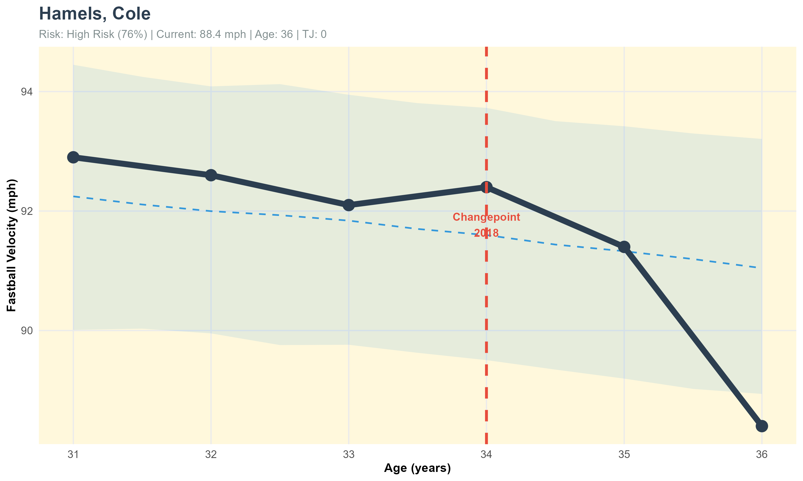
Case Study: Cole Hamels - Natural Aging Decline
Notes:
Cole Hamels is a textbook case of natural aging decline without major injury complications. He's shown here from age 31 through 36, and you can see the steady, relatively predictable decline from about 93 mph down to 88 mph over five years.
What's important is the (relative) smoothness of this decline. There's no sudden drop-off, it's approximately 1 mph per year, which matches our accelerated decline phase expectations for a pitcher in his mid-to-late 30s. The blue dashed line is our model's prediction, and you can see it tracks the actual data very closely, at least until his final season which had a major decline.
We detected a statistically significant changepoint in 2018 at age 34, indicated by the red vertical line. This is where the model identified an acceleration in decline rate. Now, Hamels didn't have Tommy John surgery, that 76% risk score you see reflects age-related risk, not injury history. This is what 'normal' aging looks like: gradual, consistent, and predictable within our model's confidence bands. When we see a pitcher following this pattern, we can forecast their future performance with reasonable confidence.
Transition: Here's another example of pure aging decline...

Slide 12
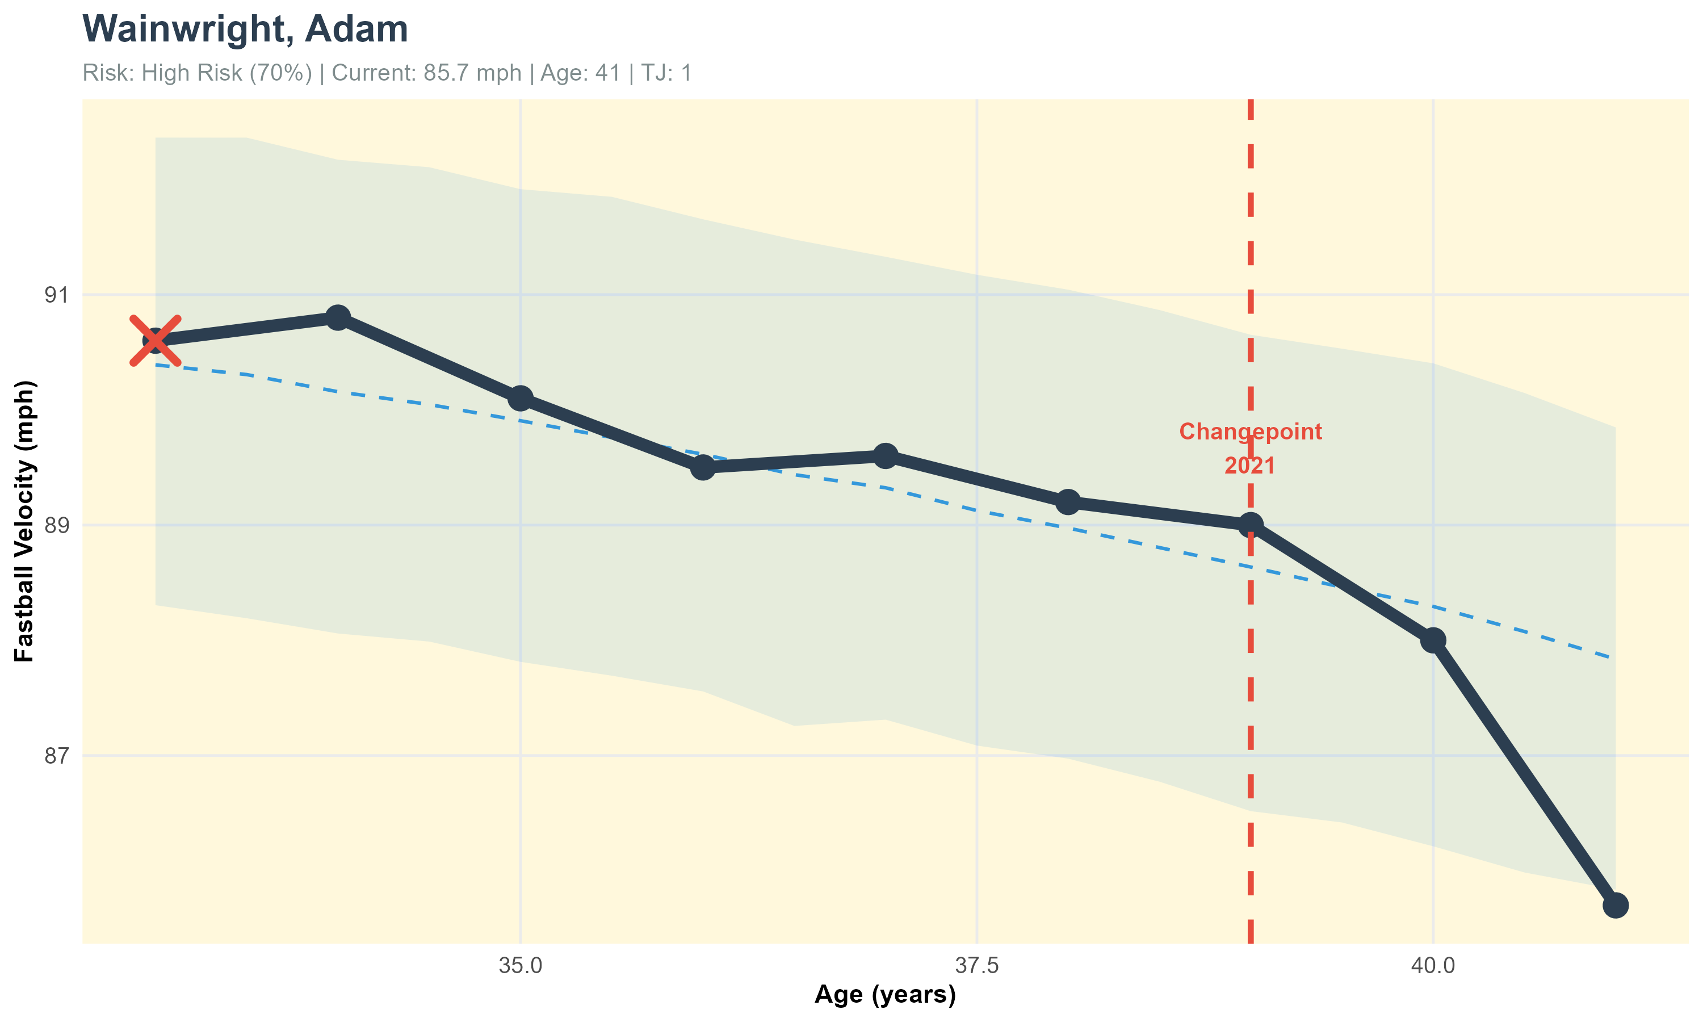
Case Study: Adam Wainwright – Natural Aging Decline
Notes:
Adam Wainwright provides another instructive case. He had Tommy John surgery back in 2011, well before our data window begins in 2015. That yellow X marker on the far left indicates that pre-existing surgery (also applied to all other aging curves when applicable).
What we see from age 33 onwards is essentially pure aging decline. His velocity drops from about 91 mph at age 33 to 85-86 mph by age 41. Our model detected a changepoint in 2021 at age 39, where the decline accelerated.
What's crucial here is distinguishing between the old Tommy John surgery from 2011 and the aging pattern we're seeing 10-15 years later. The surgery likely reset his baseline velocity, but by age 33, he was fully recovered and what we're observing is natural age-related decline. Our model accounts for this by including 'years since TJ' as a capped variable; after 5 years, we assume full recovery.
Wainwright's current 70% risk score reflects his advanced age and declining velocity as well injury concerns (although extremely minor in this case). This is a pitcher at the end of a career, declining in the expected way.
Possible Audience Question(s): (Personal Note)
How do you know the 2011 TJ surgery isn't still affecting him?
-Medical research indicates full recovery typically occurs within 18-24 months, with stabilization by year 3-5. After 15 years, we're confident the surgery is no longer the primary driver of decline. More on this later on.
Transition: Now let's look at cases where injury does play a major role...

Slide 13
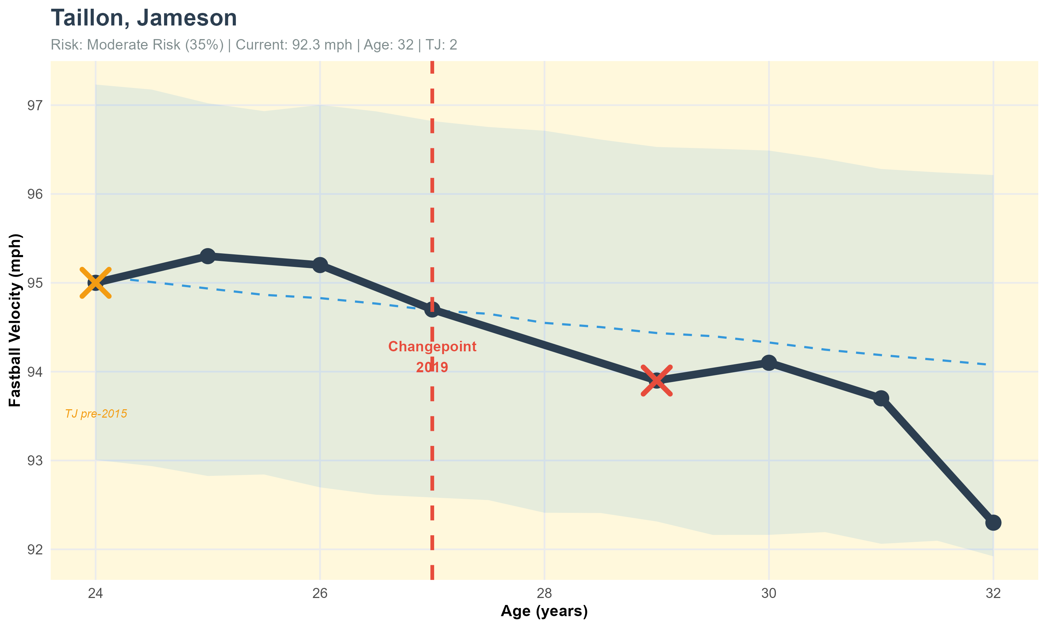
Case Study: Jameson Taillon – TJ Effects (x2) with Aging
Notes:
Jameson Taillon shows a more complex pattern: aging plus multiple Tommy John surgeries. The yellow X at age 24 indicates a pre-2015 Tommy John surgery. The red X at age 29 in 2019 shows a second surgery during our data window.
Look at the trajectory: he was maintaining 95+ mph through age 27, then notice the sharp drop after the 2019 surgery, down to about 94 mph at age 29. The model detected this as a changepoint.
What's interesting is that he stabilized at this new lower baseline around 94 mph and has maintained that through age 32. This illustrates an important pattern we see: Tommy John surgery often results in a new, lower velocity plateau rather than continuous decline. His 35% moderate risk score reflects both the injury history and approaching age-related decline. He's in a window where normal aging is beginning to compound with the after-effects of multiple surgeries.
Multiple TJ surgeries create a step-down pattern in velocity rather than a smooth curve, each surgery resets the baseline lower, then aging continues from there.
Transition: Here's an even more dramatic case...

Slide 14
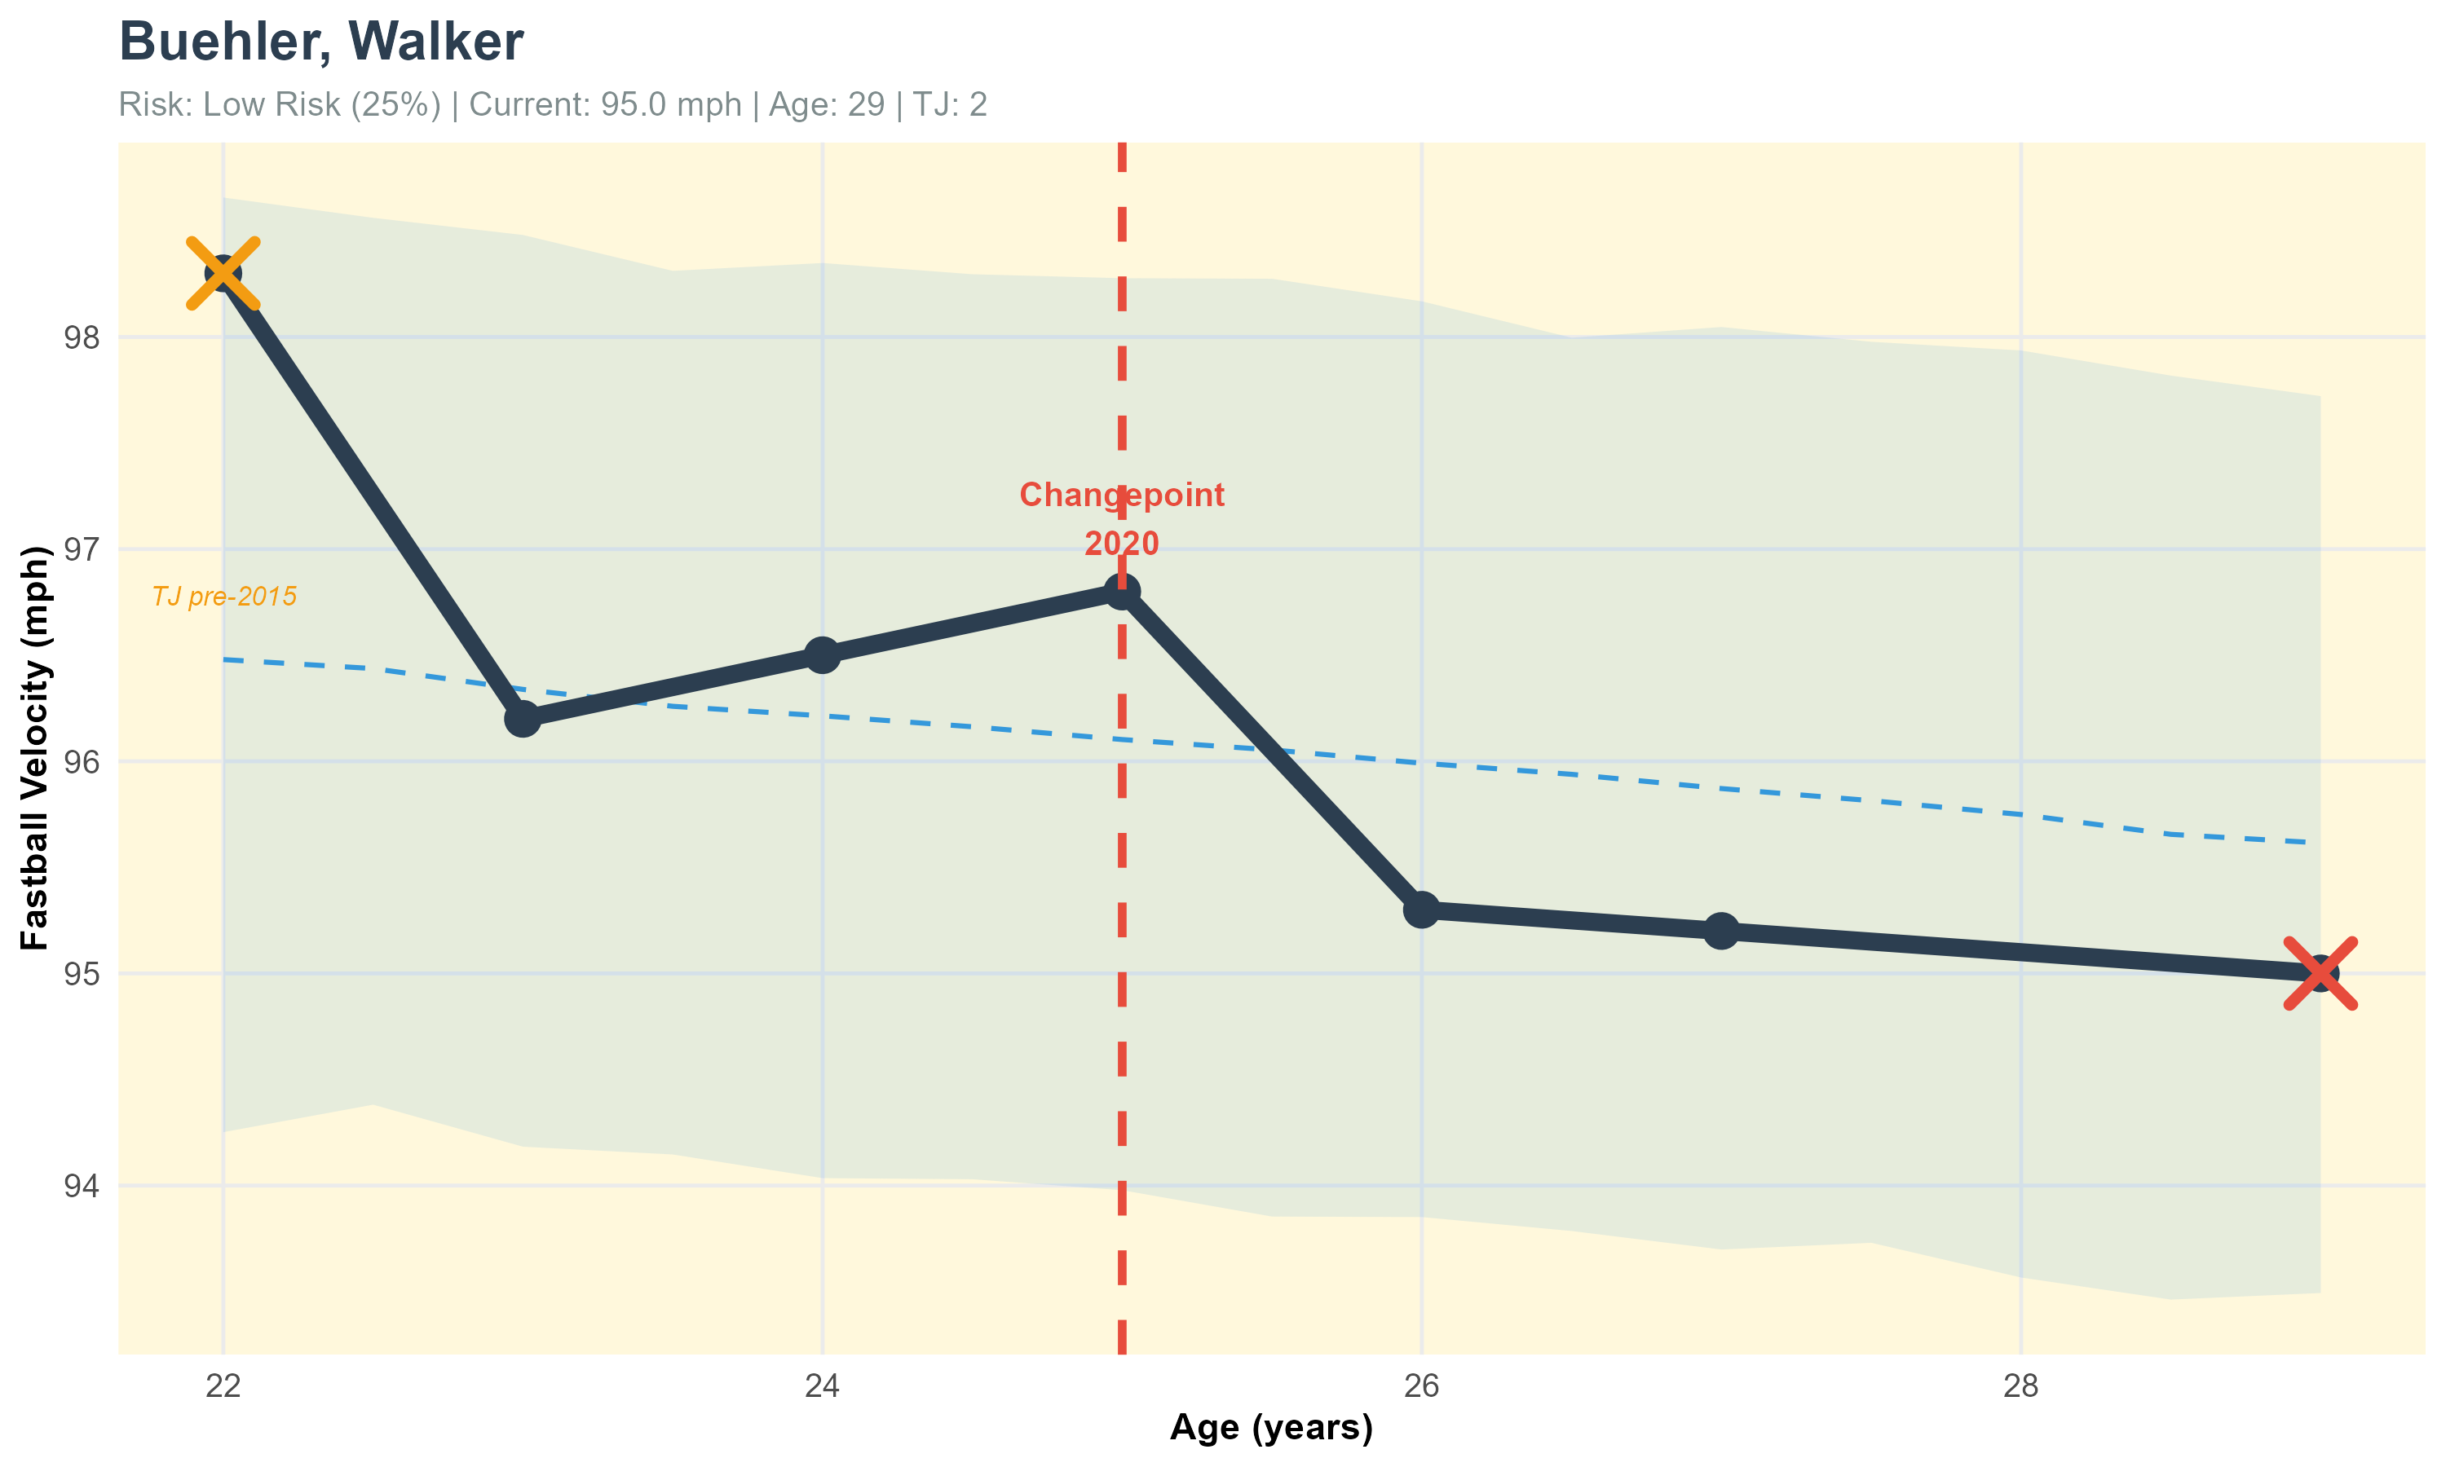
Case Study: Walker Buehler – TJ Effects (x2) while Young
Notes:
Walker Buehler is particularly interesting because he had two Tommy John surgeries while still young, one before 2015 shown by the yellow X at age 22, and another in 2020 at age 25 shown by the red X.
The striking thing here is that he started at 98+ mph at age 22, dropped to the low 96s after recovering from the second surgery, and has since declined to around 95 mph by age 29.
Now, his risk score shows as 25% - which seems low given two surgeries. Why? Because he's still young relative to the typical decline phase, and he's maintained velocity in the mid-90s, which is above league average. The model is accounting for the fact that despite the injury history, his relative age and current performance is still strong. The risk score weights current performance and age alongside injury history. He's maintained above-average velocity and is still in his prime years. The surgeries increase risk, but youth and current performance provide counterbalance.
This raises an important methodological point: our risk score is forward-looking. It's asking 'what's the probability of significant future decline?' not 'how many bad things have happened already?' Buehler's youth partially offsets his injury history in the risk calculation.
Transition: Now let's pivot to young pitchers with promising trajectories...

Slide 15
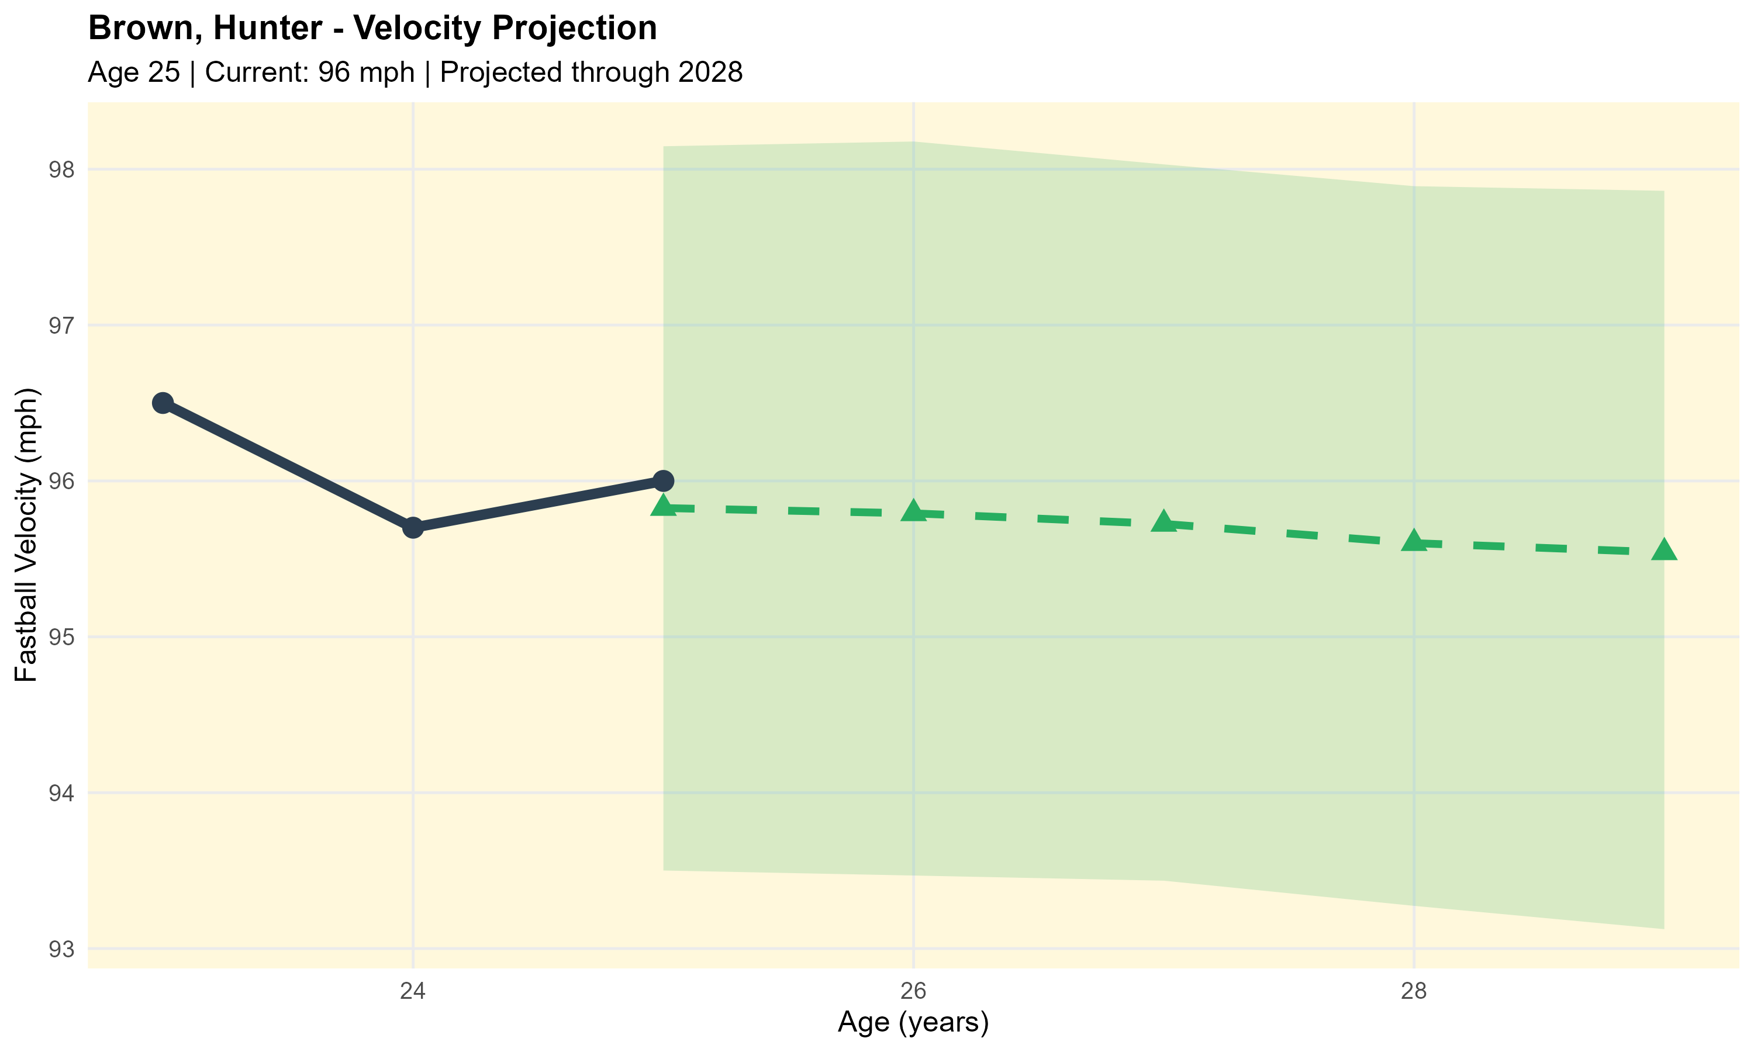
Case Study: Hunter Brown – Velocity Predictions
Notes:
Hunter Brown represents the kind of projection our model can make for developing pitchers. He's 25 years old, currently throwing 96 mph, with no Tommy John history. The green shaded region shows our projection through age 29.
Notice a few things: First, we project slight short-term decline, from 96 mph down to about 95.5 mph over the next four years. This might seem pessimistic for a young pitcher, but it reflects regression toward the mean, extremely high-velocity pitchers tend to lose a bit more velocity than average during aging, and our model is being conservative. Plus, he’s coming out of what we’ve identified as the “peak-range” so to say.
Second, look at the width of that confidence band - it's quite wide, especially in the outer years. That's appropriate uncertainty quantification. We're less certain about 2028 projections than 2025 projections.
Third, notice the footer note: 'Projections regress toward population mean (conservative for elite performers).' This is a feature, not a bug - our model doesn't assume every 96 mph thrower will maintain elite velocity. Some will, some won't, so the population-average projection is intentionally conservative.
For front office use, this kind of projection helps with arbitration valuations and extension negotiations (plus other things, these are just some examples). You can project future performance probabilistically rather than just extrapolating current stats linearly.
*Conservative projections are better than optimistic projections for risk management - you'd rather be pleasantly surprised than unpleasantly surprised.
Transition: Here's another young pitcher projection..

Slide 16
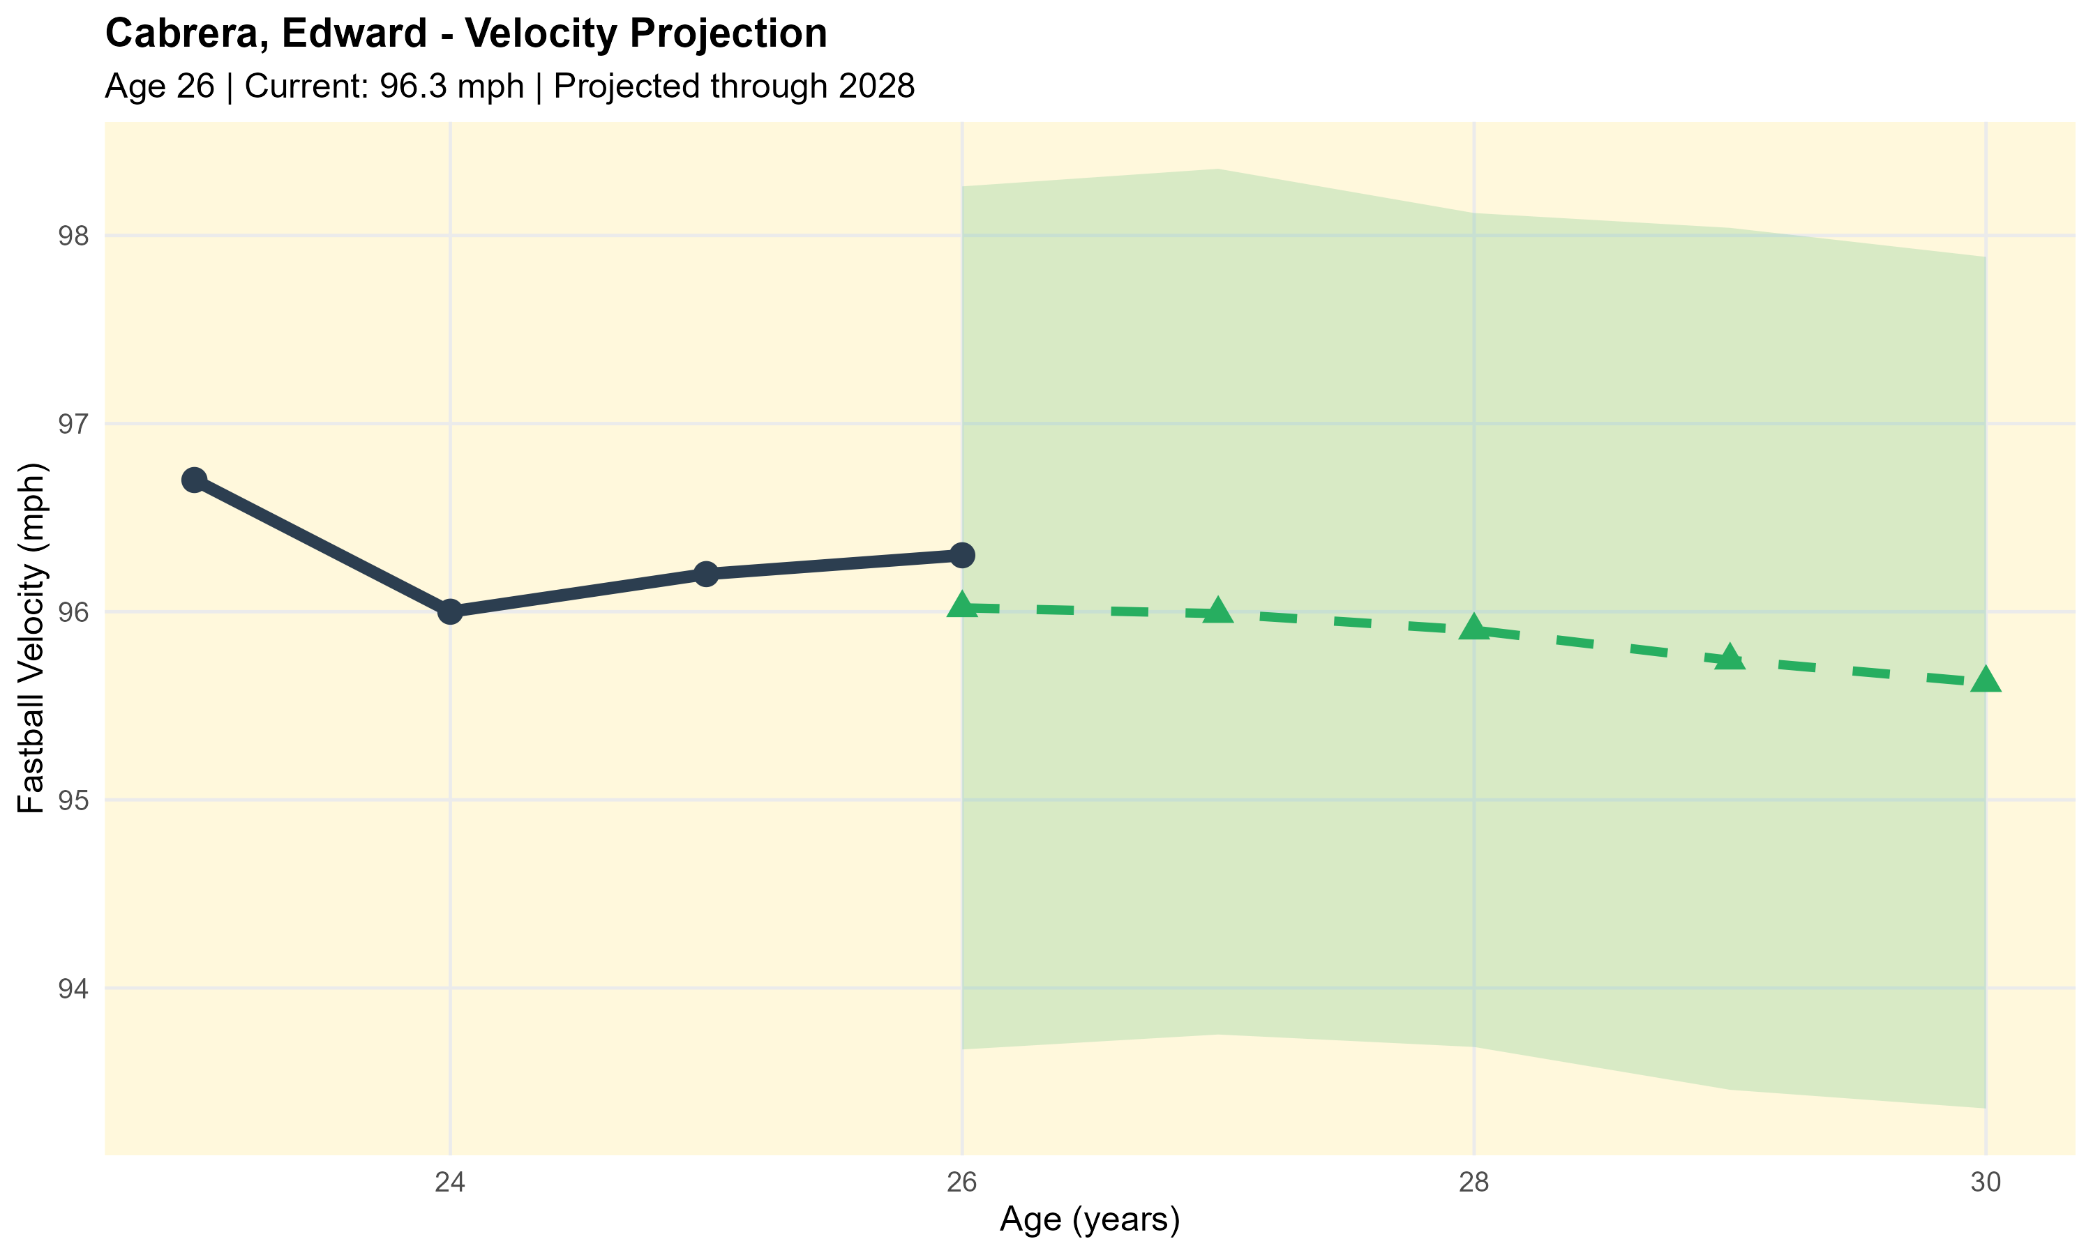
Case Study: Edward Cabrera – Velocity Predictions
Notes:
Edward Cabrera at age 26 is basically at peak velocity: 96.3 mph currently. Our projection shows him declining gradually to about 95.5 mph by age 30, with similar conservative assumptions to the Brown projection.
What I want to highlight here is the value of this for team planning. If you're considering a 4-year extension for Cabrera, this projection lets you model probable performance over the contract life. You can estimate WAR based on velocity projections, which feeds into dollars-per-WAR calculations.
The model suggests he'll lose roughly 0.8 mph over four years if healthy, that's slower decline than average because he's still in prime years. That's valuable information for contract structuring.
Transition: I have a couple other cases worth mentioning briefly...

Slide 17


Additional Case Studies
Jacob Degrom:
• Age 36, 97.3 mph current, 2 TJ surgeries
• Risk: 34.2% (Moderate)
• Elite velocity maintained despite injuries
George Kirby: (Prediction)
• Age 27, 96 mph current, 0 TJ surgeries
• Risk: 13% (Low)
• Young age and model’s predictions are favorable
Notes:
I want to quickly mention two other case studies I analyzed but aren't showing in detail due to time.
Jacob deGrom is fascinating: he's 36 years old, still throwing ~97 mph, and has had two Tommy John surgeries. His risk score is 34%, which is moderate. Why not higher? Because his current velocity is still elite. The model recognizes that despite age and injury history; he's performing at an extremely high level currently. This is the model doing what it should - balancing multiple risk factors rather than being driven by any single factor.
George Kirby, currently at 96 mph with no TJ history and only 13% risk. Clean injury history plus ideal age results in low projected risk.
*The key insight here is that our framework handles nuanced risk assessment. It's not just 'old = risky' or 'TJ = risky' - it's a weighted combination of multiple factors that produces differentiated evaluations.
Transition: Let me summarize the key takeaways from this research..

Slide 18

Key Takeaways I
WE CAN SEPARATE AGING FROM INJURY
VELOCITY SHOWS CLEAR PATTERNS
ACTIONABLE FRAMEWORK
APPLICABLE TO ALL CAREER STAGES
Bayesian models + changepoint detection = quantitative discrimination
Peak at mid 20’s, predictable decline, measurable TJ effects
Risk scores, projections, uncertainty quantification
Veterans (retrospective) AND rookies (prospective)
Able to develop actionable, practical impacts!
Notes:
A few main takeaways from this work:
First, yes - we can quantitatively separate aging from injury. The combination of Bayesian hierarchical modeling and changepoint detection gives us the tools to distinguish predictable age-related decline from injury-driven structural breaks. This isn't just an academic exercise - it has real practical value for player evaluation.
Second, velocity shows clear, predictable patterns. We found peak velocity at age 24-26, systematic decline rates that vary by age phase, and a measurable Tommy John effect of approximately 1.5 mph velocity loss that persists beyond initial recovery.
Third, individual trajectories are detectable early. Our changepoint detection can flag concerning decline within a few seasons rather than requiring large multi-year patterns to become obvious. That early detection has substantial value for roster management.
The bottom line is that we're moving from subjective judgment - 'does this guy look done?' to quantitative assessment with proper uncertainty bounds.
Transition: Now, there's one specific aspect of Tommy John recovery I want to dive deeper into.

Slide 19
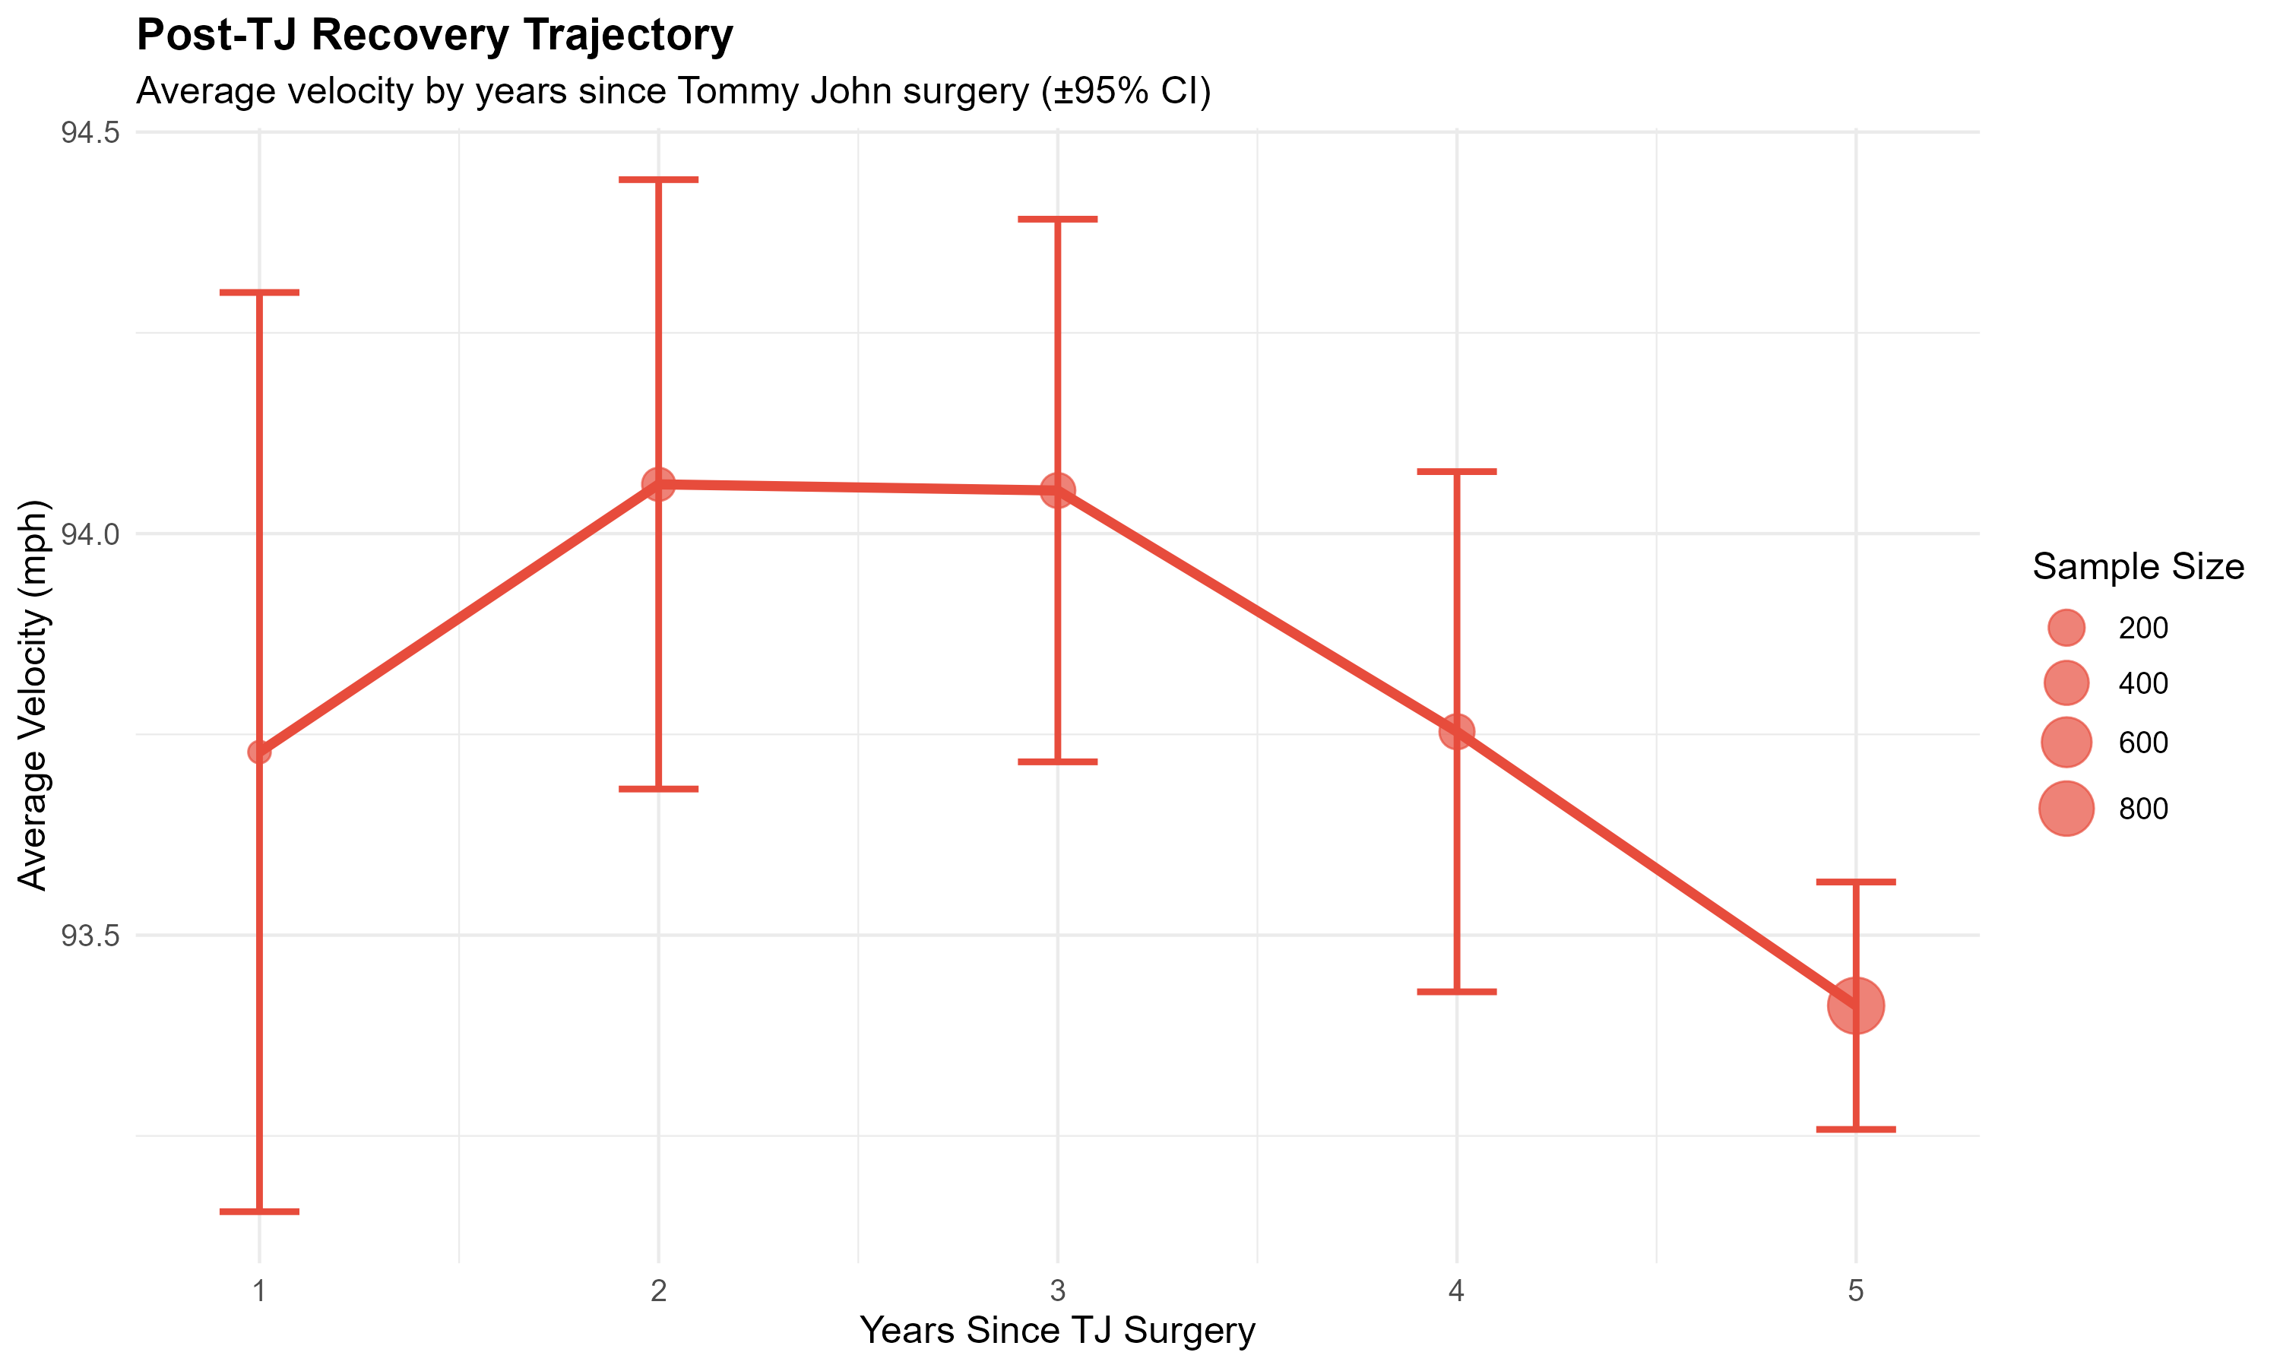
Key Takeaways II: Quantifying Tommy John Impact
Notes:
This graph shows the recovery trajectory, aggregated across all pitchers in our sample who had documented Tommy John surgeries with at least five years of post-surgery data.
The error bars represent 95% confidence intervals based on actual observed velocities. Notice how wide they are in Year 1 - that reflects the high individual variation in recovery. Some pitchers bounce back quickly, others struggle.
The pattern I mentioned is clearly visible: dip to about 93.7 mph in Year 1, recovery to 94.8 mph by Year 2-3, then relative stability around 95 mph in Years 4-5.
*Now, here's what this doesn't show: survivorship bias. Pitchers who don't make it back to the majors aren't in this dataset. So, these numbers represent successful or at least return post-Tommy John recoveries. The true average impact is likely larger when you account for players who never return. That said, this is what front offices are evaluating - pitchers who did return. So, for contract valuation of post-TJ pitchers, this is the relevant distribution.
Possible Audience Question(s): (Personal Note)
How does this compare to the popular narrative that velocity increases after TJ?
-That narrative typically comes from young pitchers who undergo TJ during their natural development phase. When you control for age, the surgery itself has a negative effect. A 24-year-old might throw harder at 26 post-TJ than at 24 pre-TJ, but that's development, not TJ. A 30-year-old will almost always throw slower post-TJ than pre-TJ. Also, as I mentioned there is other factors such as mechanic adjustments or strong rehab programs that also affect this.
Transition: Now let me address model performance and validation...

Slide 20
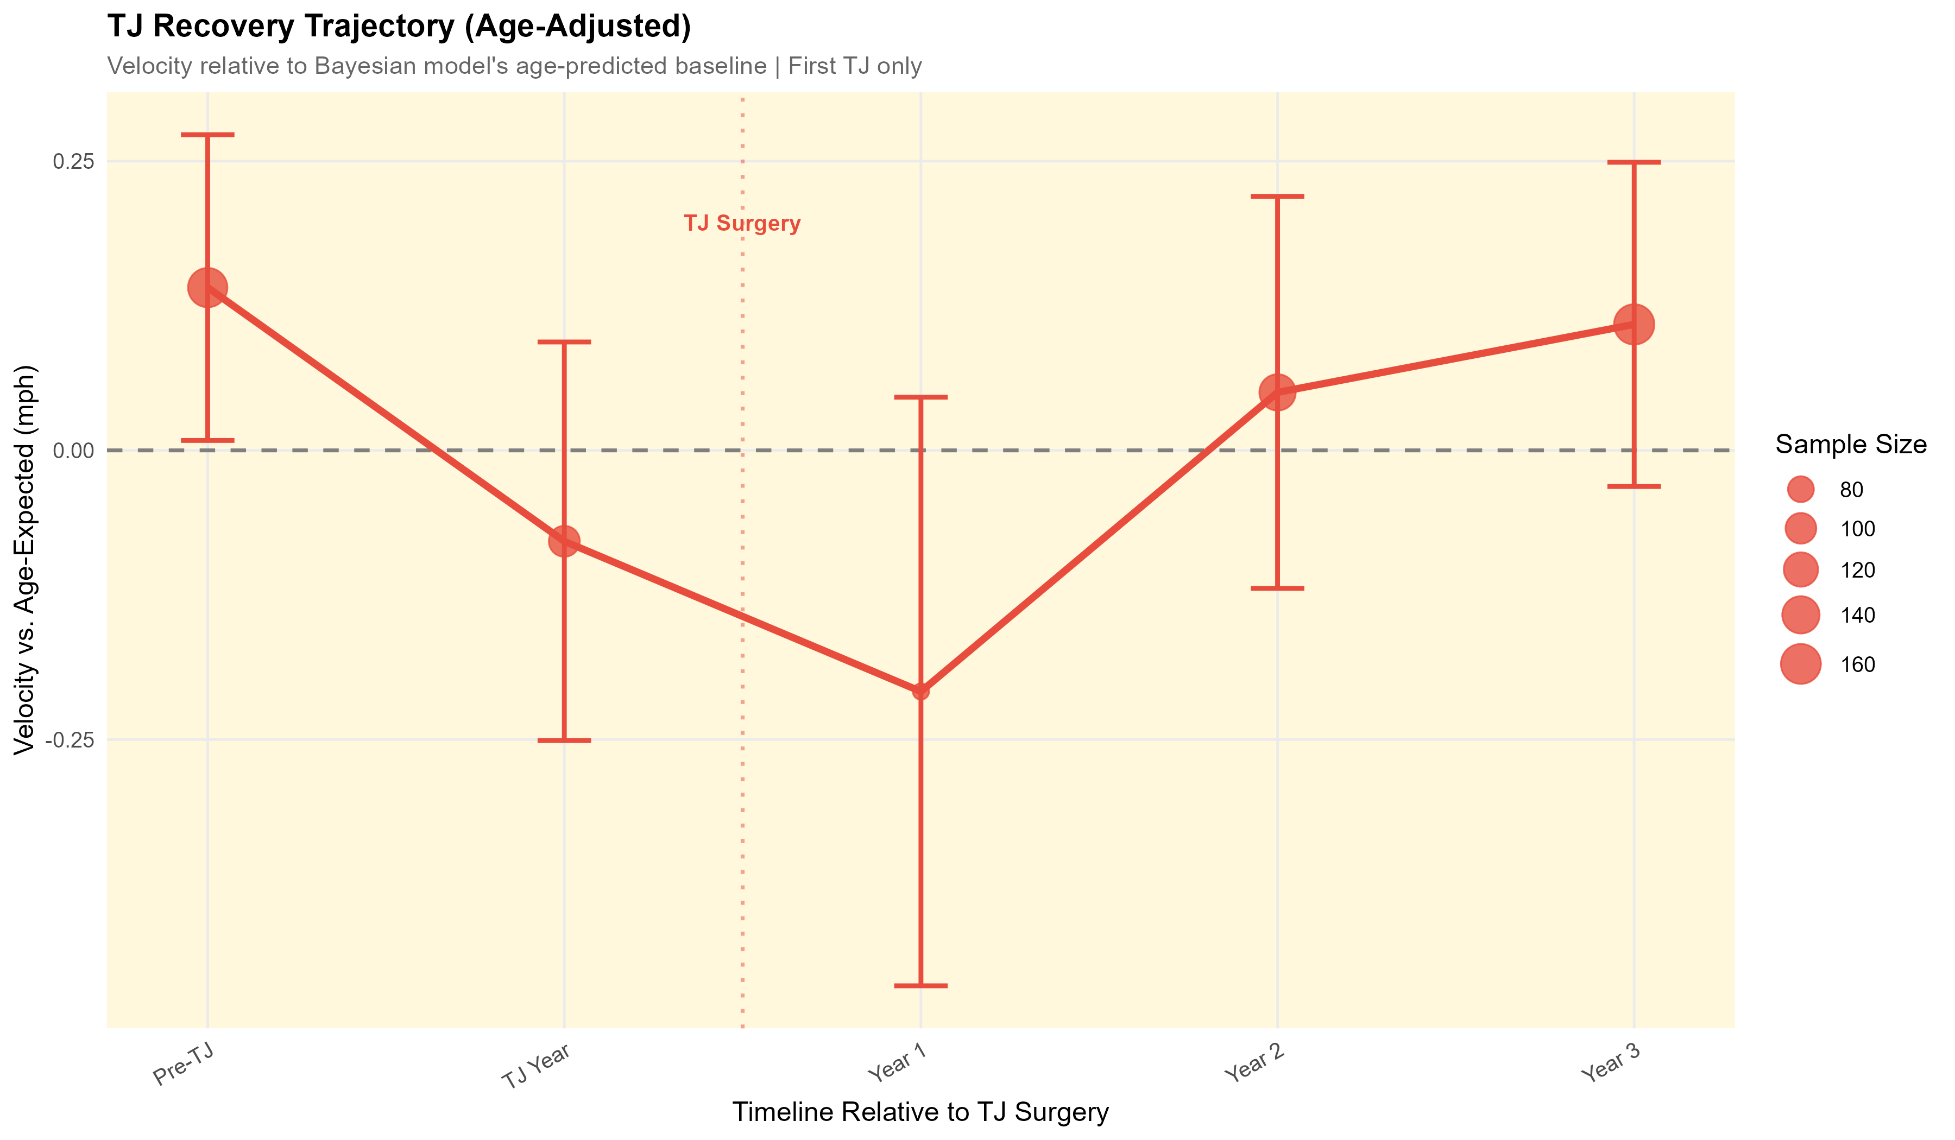
Key Takeaways II: Quantifying Tommy John Impact
Notes:
The error bars represent 95% confidence intervals based on actual observed velocities. Notice how wide they are in Year 1 - that reflects the high individual variation in recovery. Some pitchers bounce back quickly, others struggle.
The pattern I mentioned is clearly visible: dip to about 93.7 mph in Year 1, recovery to 94.8 mph by Year 2-3, then relative stability around 95 mph in Years 4-5.
This graph shows the injury recovery trajectory, aggregated across all pitcher in our sample who had documented TJ jurgeries with at least 3 years of pre and post TJ data. We can see a trend that supports industry beliefs regarding TJ. We can see gradual decline in the years leading up to TJ, suggesting possible deterioration in the UCL. And then post-TJ, we see a rise back in velo
*Now, here's what this doesn't show: survivorship bias. Pitchers who don't make it back to the majors aren't in this dataset. So, these numbers represent successful or at least return post-Tommy John recoveries. The true average impact is likely larger when you account for players who never return. That said, this is what front offices are evaluating - pitchers who did return. So, for contract valuation of post-TJ pitchers, this is the relevant distribution.
Transition: Now let me address model performance and validation...

Slide 21
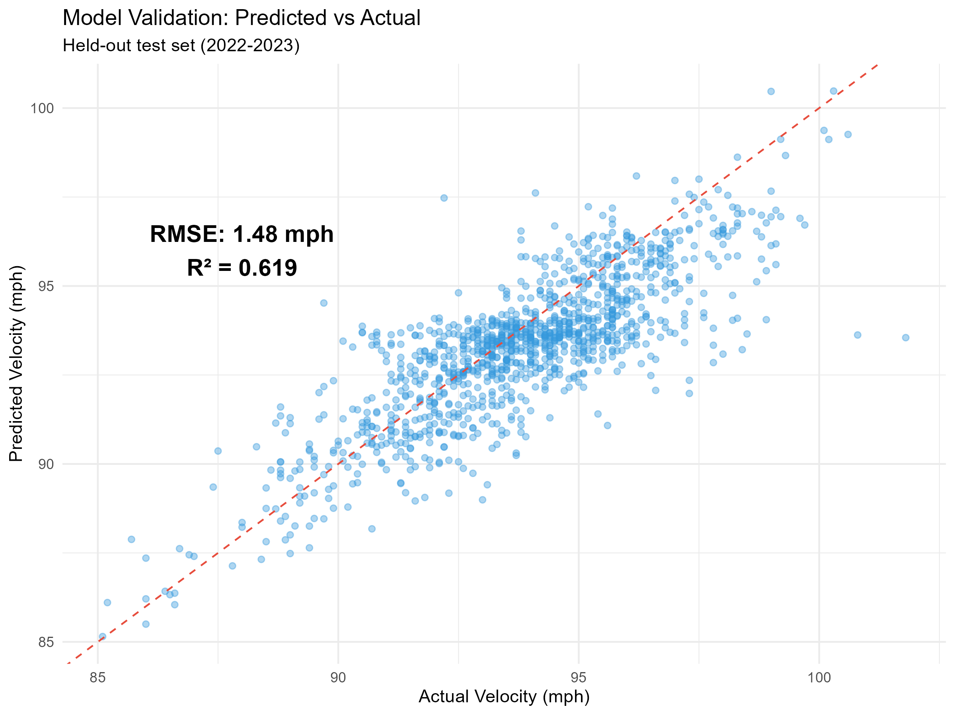
Model Performance & Validation
Training data: 2015-2021
Test Set: 2022-2023
VELOCITY PREDICTION ACCURACY:
• RMSE: 1.48 mph
• MAE: 1.12 mph
• R²: 0.619 (62% of variance explained)
INTERPRETATION:
• Model captures primary aging/injury signals
• Remaining variance: individual biomechanics, training, workload, etc.
Notes:
Evaluating model performance…
I used a held-out test set consisting of the 2022-2023 seasons. The model was trained only on 2015-2021 data, then evaluated on its ability to predict 2022-2023 velocities.
Our velocity prediction accuracy was: RMSE of 1.48 mph. On a baseline of roughly 90 mph, that's about 1.7% error. MAE of 1.12 mph mean absolute error. And R² of 0.619, meaning we explain ~62% of velocity variance.
Now, I know what some of you might be thinking - 'only 62%?' Let me provide context. Biological systems are inherently noisy. Day-to-day pitcher velocity naturally varies by 1-2 mph based on fatigue, mechanics, even weather. Published aging curve research typically achieves R² in the 0.55-0.70 range, so 0.629 is competitive with the literature. The unexplained 37% of variance represents factors we can't measure: individual biomechanics, training intensity, pitch sequencing strategy, measurement error in Statcast, minor injuries that don't require surgery. That variance is real, and we shouldn't claim to explain it.
For risk assessment correlation, our overall risk scores achieved R² of 0.619 against actual future decline. That's strong evidence the risk framework captures meaningful predictive information.
*The key point is: these metrics are appropriate for the complexity of human athletic performance. We're not trying to predict physics, we're trying to predict biology, which is fundamentally noisier.
Possible Audience Question(s): (Personal Note)
Could you get higher R² with more features?
-Possibly, but you risk overfitting. We prioritized generalizability over training set fit. Adding features like workload or pitch mix might help but increases data requirements and model complexity.
Transition: There are some interesting additional patterns worth noting...

Slide 22
Potential Takeaways
• Velo may go up if a pitcher’s velo has been held back by a slowly deteriorating UCL
• Velo may go up if TJ takes place during a player’s natural velocity increase/development period (i.e. developing young players)
• Velo may go up because of the rehab process with energized discipline and increased strength in the legs, core, and arm
With these in mind, we can say that TJ surgery may be associated with increased velocity, but TJ surgery is not causal to increased velo
Byproducts of a TJ surgery rehab program for example new leg strength, can lead to yielding new velo
Players following TJ surgery and rehab tend to concentrate much more on developing great pitching mechanics
Notes:
A few more nuanced findings worth mentioning:
First, velocity may actually increase if a pitcher's UCL was slowly deteriorating before surgery. We see this occasionally - a pitcher whose velocity had been declining gets TJ, and afterwards throws slightly harder than immediately pre-surgery. Why? Because the chronic ligament damage was limiting arm speed, and the repaired ligament temporarily restores function. This is different from the naive 'TJ increases velocity' claim - it's more like 'TJ restores velocity that was being suppressed by injury.’
Second, timing matters. If TJ occurs during a player's natural development window - say, age 22-24 - the surgery might interrupt but not prevent development. That player might still improve with age even accounting for surgical effects. This is why young pitchers sometimes look like they 'gained velocity' from TJ - they were going to gain velocity anyway from aging 23 to 25, the surgery just happened in the middle.
Third, we see correlation between decline magnitude and future injury risk. Pitchers who are declining faster than predicted by age alone have elevated TJ risk in subsequent seasons. This suggests velocity decline might be an early warning signal of UCL stress before catastrophic failure occurs.
Transition: Let me discuss practical applications...

Slide 23
Practical Applications
CONTRACT NEGOTIATIONS:
INJURY RECOVERY:
ROSTER MANAGEMENT:
TRADE TIMING:
EARLY-CAREER PROJECTIONS:
Objective risk assessment for free agents
Set realistic TJ recovery expectations
Monitor entire pitching staff risk profiles
Identify pitchers approaching high-risk windows
Optimize workload during peak years
Project velocity through contract years with uncertainty
Identify problematic recoveries early
Inform demotion/DFA decisions objectively
Maximize return before market recognizes decline
Support development and identify pitcher-specific decline onset timing
Notes:
So how does this research translate to actual front office decisions?
Contract Negotiations: When evaluating a multi-year deal for a 31-year-old pitcher, you can model expected velocity decline over the contract term. If the pitcher is projected to decline from 94 to 92 mph over four years, you can estimate impact and structure guarantees accordingly. Our framework provides the probability distribution for those projections.
Trade Deadline Decisions: If you're considering trading for a rental starter, understanding their current trajectory matters. Is their recent velocity dip normal aging or a red flag? Changepoint detection can flag concerning drops early.
Extension Timing: Our risk scores help identify optimal extension windows. A 26-year-old with clean injury history and low risk is a better extension candidate than a 28-year-old with moderate risk, even if current performance is similar.
Prospect Evaluation: Young pitchers showing unusual velocity gains might be reaching physical maturity ahead of schedule, which affects their projection curve. This could be because they’re also just a dawg.
Medical Decision Support: Velocity tracking post-injury can inform return-to-play decisions and help calibrate expectations for recovery timelines.
The key is that this provides quantitative input to decisions that used to rely primarily on traditional aging beliefs and past performance.
Transition: Now, I want to address some current limitations..

Slide 24
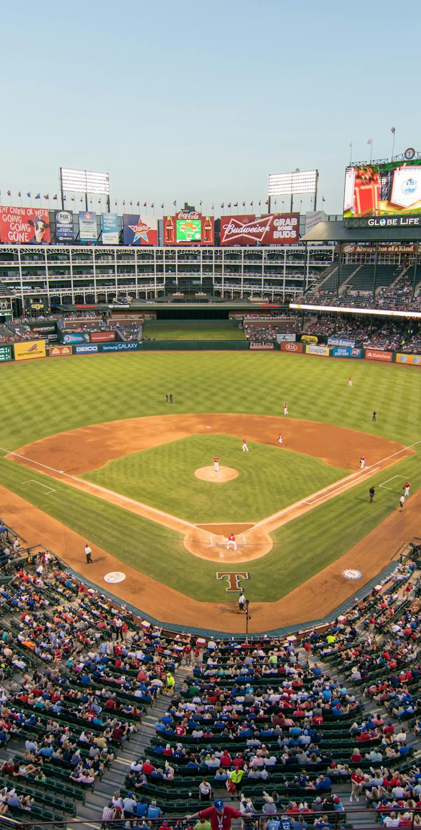
Current Limitations & Constraints
⚠️ PITCH TYPE: Four-seam fastball only (Currently)
→ Other pitch types show different aging patterns
⚠️ TIME PERIOD: 2015-2024 (Personally selected Statcast era)
⚠️ INJURY DATA: Tommy John surgery data only
→ Other injuries (shoulder, arm, back, etc.) not yet modeled
⚠️ VELOCITY ONLY: Command and movement excluded
Notes:
Every research project has limitations, and I want to be transparent about mine.
First, I focused exclusively on four-seam fastball velocity for this project. Other pitch types have different aging patterns: sliders and curveballs depend more on spin and command than pure arm speed. This was a deliberate choice to maximize precision on one metric, but it means we're not capturing the complete picture of pitcher decline, rather focusing on velocity effects here.
Second, our time period is 2015-2024, which is the Statcast era. This is when measurement became consistent, but it also means we can't include career data pre-2015. Some aging patterns might look different in earlier eras with different training methods and medical technology, etc.
Third, our injury data is limited to Tommy John surgeries. Shoulder injuries, lat strains, and other arm issues aren't captured systematically. It’s difficult to find open-source organized structure for these so I’m currently missing other injury effects that (might) influence velocity, however TJ is the most prevalent one, so I started by focusing on TJ.
Fourth, we don't account for workload yet: innings pitched, pitch count, multi-inning relief appearances. Workload likely affects aging rates, but not implemented in this project before the deadline. Will definitely be implemented soon though, more on this in the next slide.
Finally, survivor bias: our model is trained on pitchers who made it to MLB and stayed long enough for us to observe aging. We're not modeling the full population of professional pitchers, just those who achieved sustained MLB success (minimum 4 seasons).
These aren't fatal flaws, they're known constraints that bound the scope of our claims. Future work can address several of these, as I’ll mention on the next slide
Transition: Which brings me to future directions...

Slide 25
1️⃣ EXPAND PITCH TYPES
2️⃣ WORKLOAD INTEGRATION
4️⃣ OPTIMIZE RISK FRAMEWORK
Breaking balls, off-speed pitches; pitch-specific decline models
Pitch-specific aging curves
Innings pitched, pitch counts, days rest, high-stress innings, etc.
Biomechanical stress indicators (High-effort pitches, max effort pitch percentage, usage patterns, etc.)
Elbow, shoulder, back injuries, etc.
3️⃣ INJURY PREDICTION BEYOND RISK SCORES
Biomechanical risk factors (Arm slot, release point variance, shoulder/elbow torque estimates, etc.)
Data-driven weight learning
Machine learning ensemble methods
Future Work & Extensions
Notes:
There are several exciting directions for extending this work. (and even more that aren’t listed here!)
Multi-metric integration: Combine velocity with command and movement models for comprehensive performance projections. The statistical framework is already built - we just need to refine measurement for the other metrics.
Workload incorporation: Integrate pitch counts, innings, and multi-inning appearances. Workload almost certainly affects aging, and incorporating it would improve projections substantially.
Injury prediction: Rather than just modeling post-injury effects, can we predict pre-injury risk? Velocity decline patterns might serve as early warning signals for UCL stress. This would require prospective validation but has enormous practical value.
Pitch type expansion: Model aging curves for sliders, curveballs, changeups. Different pitch types age differently and this matters for pitcher valuation.
Survival modeling: Incorporate career longevity explicitly. Right now we model velocity conditional on still pitching; we could extend to model probability of remaining in MLB.
Biomechanical integration: If we could get motion capture data on delivery mechanics, we could potentially explain some of the currently unexplained variance in aging rates.
These extensions would require partnerships with teams who have proprietary data, but the statistical framework we've built is designed to accommodate them.
Transition: Let me talk about the methodological contribution..

Slide 26

Methodological Contribution
UNIFIED AGING-INJURY FRAMEWORK
INDIVIDUAL CHANGEPOINT DETECTION
ACTIONABLE RISK ASSESSMENT
COLLABORATION:
Prior Approach: Aging curves and injury research existed in silos
Contribution: Created a framework to model both simultaneously
Bayesian hierarchal structure separates injury from aging effects
Team partnerships for prospective validation
Prior Approach: Binary “healthy/injured” classifications
Contribution: Multi-component probabilistic framework
Continuous 0-1 scale with interpretable categories
Academic extensions (workload, biomechanics)
Code available for replication (GitHub & Contact)
Prior Approach: Population curves masked individual decline timing
Contribution: Algorithmic structural break detection (PELT)
Properly uncertainty quantification via posterior distribution
Notes:
I want to close by emphasizing the methodological innovation here
I believe my three key contributions are:
Created a unified aging-injury framework. Prior research studied aging curves and injury effects separately, at least in widespread publicly available research. I built a single statistical model that captures both simultaneously. The Bayesian hierarchical structure naturally handles the interaction: players have individual aging trajectories that can be disrupted by injury, and the model quantifies both effects with proper uncertainty.
Second, I demonstrated individual changepoint detection at scale. Population aging curves are useful, but teams need to know when individual players deviate from expectation. The PELT algorithm gives us automated, statistically principled detection of trajectory breaks. This is applicable beyond baseball: any time-series process where you want to detect regime changes could use this approach.
Third, I developed actionable risk assessment that integrates multiple factors into a single continuous score. Six independent risk components - age, velocity, decline rate, changepoints, injury history, recovery phase - combined into one interpretable metric from 0 to 1. This is practical for decision-making because it collapses complexity into a single dimension while preserving the underlying multivariate information.
The broader contribution is demonstrating how Bayesian methods, modern changepoint algorithms, and risk quantification can be combined for sports analytics problems. This framework could apply to other positions, other sports, or even non-sports contexts like equipment maintenance or financial market analysis.
I extremely open to collaborations: team partnerships for prospective validation, academic extensions incorporating biomechanics or workload, or applications to other sports entirely. My code is available on GitHub for replication and extension.
Transition: Let me acknowledge the research this builds on..

Slide 27
Sourced Research & References
Ahmad, Christopher S. "Question: Will My Velocity Go Up After Tommy John Surgery?"
Medium, 2023, drchrisahmad.medium.com/question-will-my-velocity-go-up-after-
tommy-john-surgery-2fbfe03ccbcd.
Driveline Baseball. "The Makeup of a Pitcher Debuting in the Major Leagues."
Driveline Baseball, 15 Sept. 2021, www.drivelinebaseball.com/2021/09/
the-makeup-of-a-pitcher-debuting-in-the-major-leagues/.
Roegele, Jon. "Tommy John Surgery List." Google Sheets, 2015-2024, docs.google.com/spreadsheets/d/1gQujXQQGOVNaiuwSN680Hq-FDVsCwvN-3AazykOBON0/.
Notes:
This work stands on the shoulders of excellent prior research. A few key citations:
Chris Ahmad's 2023 analysis of Tommy John velocity effects was foundational for my recovery timeline expectations.
Mitchel Lichtman's aging curve work established many of the baseline patterns I built on.
Jon Roegele's comprehensive Tommy John surgery database was essential - his meticulous tracking of surgical dates enabled our recovery timeline analysis. Absolute godsend.
Stan Conte's workload research informed our thinking about injury risk factors, even though I couldn't fully incorporate workload in this iteration.
And numerous academic papers on Bayesian hierarchical modeling and changepoint detection provided the statistical foundation.
I want to emphasize that this research is incremental - it advances the conversation but doesn't reinvent it. I’m integrating existing methods in a novel way and applying them rigorously to a specific problem.
Transition: With that, I'll open it up for questions...

Slide 28

Thank You!
Questions?
nickbartle2@gmail.com
linkedin.com/in/nickolasbartle/
(919)-656-2434
https://nbartle26.github.io/DigitalPortfolio/
Notes:
Thank you for your attention. I'm happy to take questions now, and I'll be around all day if anyone wants to discuss the methodology or applications in more detail.
For those interested in code replication or collaboration, please feel free to reach out, it is also available on my GitHub and website mentioned at the bottom of the slide. I’m excited about the potential for this framework and eager to see how it might be refined and extended by the community.
Possible Audience Question(s): (Personal Note)
If a team could only use one output from your model, what should it be?
-The risk scores. They're simple, interpretable, and integrate all the information into one number. You can sort your roster by risk and immediately see who warrants close monitoring, amongst so much other things.
What would you need to make this truly production-ready for front offices?
-Real-time integration with pitch tracking systems, incorporation of workload data, and extension to other pitch types, plus cutting edge biomechanics data surely wouldn’t hurt. Technically it’s ready, but those integrations would make it seamlessly fit into existing workflows."
Do you think velocity focus over-emphasizes power pitchers?
-That's fair criticism. Command-and-control pitchers might age differently, and our framework wouldn't capture that. But I'd argue velocity is the most fundamental athletic capacity - even finesse pitchers need minimum velocity to be effective. So it's a useful starting point even if incomplete.
How would you handle relievers vs. starters differently?
-Great question. Relievers might age differently because they work at higher effort levels but accumulate less volume. Future work should stratify by role. Our current model pools them together
Closing Statement: The bottom line is simple: when a veteran pitcher's velocity drops, we can now answer the question 'is this aging or injury?' with quantitative precision rather than subjective judgment. That distinction has enormous practical value for roster management, contract negotiation, and player development. Thank you.

